Slide 1
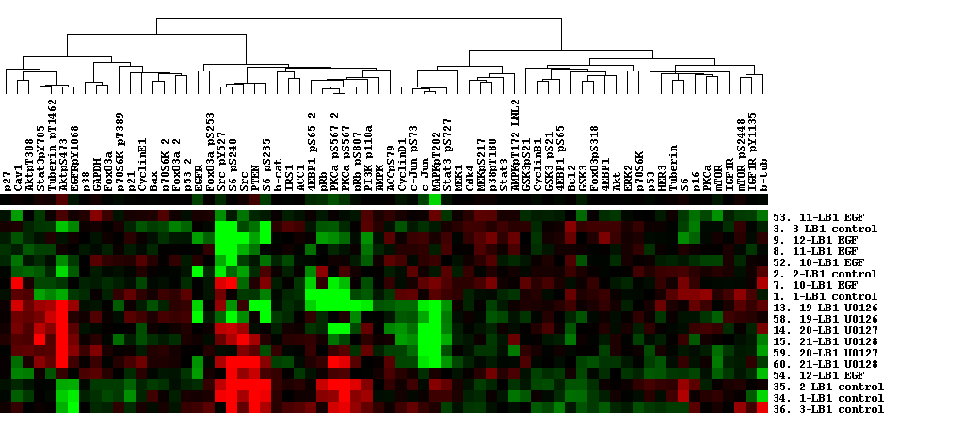
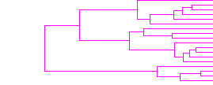
LBNL2
LB1 All Samples
Pearson Correlation

Slide 2
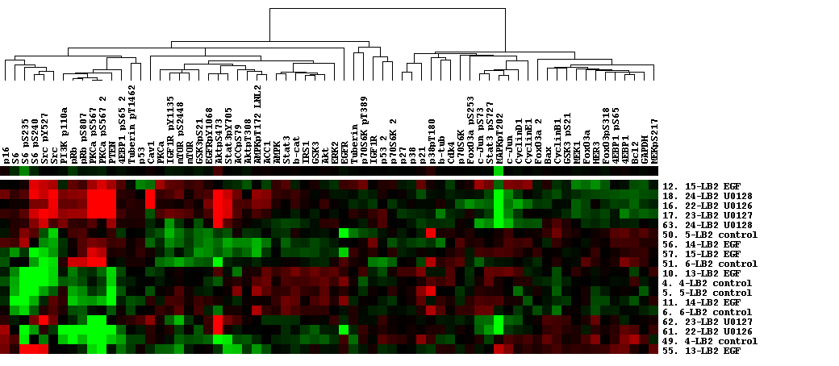
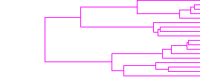
LBNL2
LB2 All Samples
Pearson Correlation

Slide 3
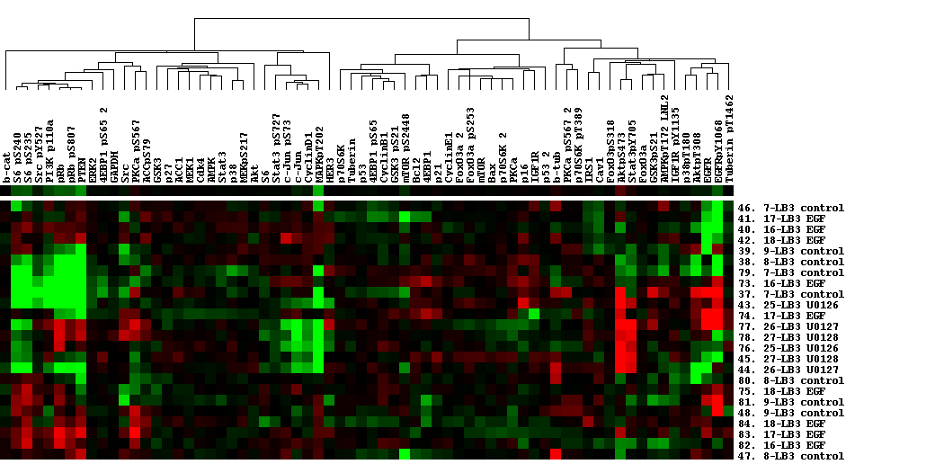
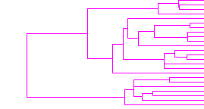
LBNL2
LB3 All Samples
Pearson Correlation

Slide 4
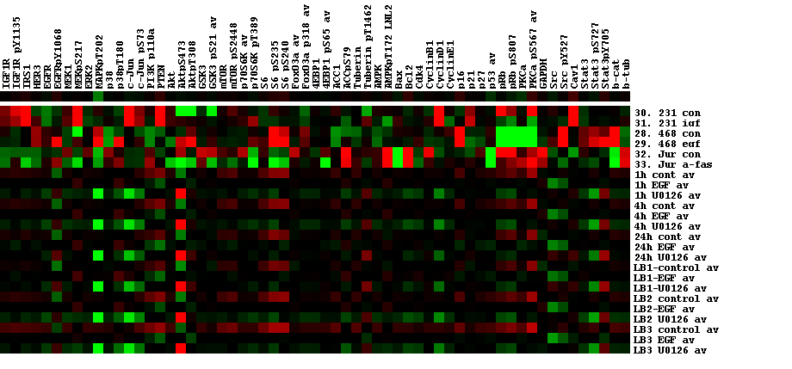
LBNL2
All Samples Averaged
Median Centered by Standards, Time, or LB then Combined
Heatmap

Slide 5
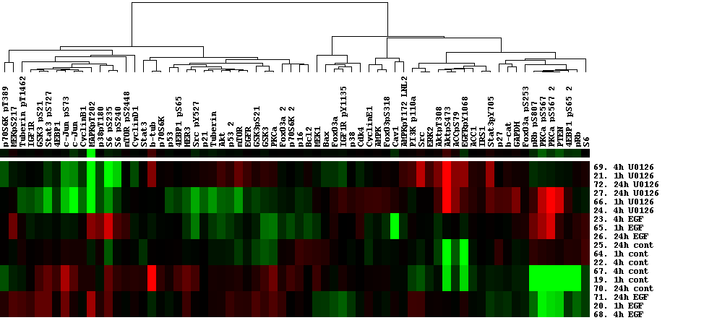
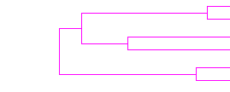
LBNL2
U0126 Treatment All Samples All Time Intervals
Median Centered by Time then Combined
Pearson Correlation

Slide 6
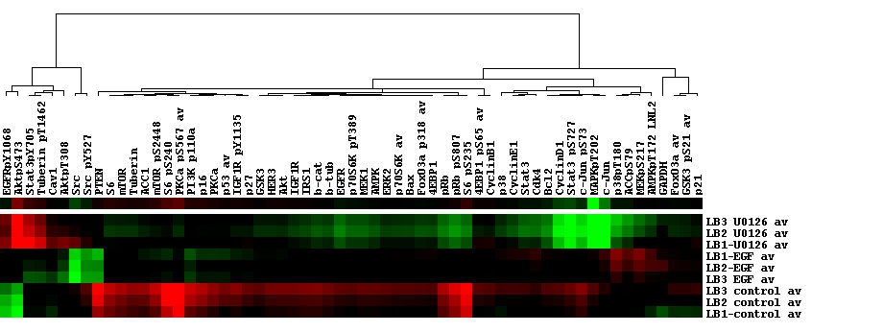

LBNL2
LB1-LB3 Averaged Samples
Median Centered Separately by LB then Combined
Pearson Correlation

Slide 7
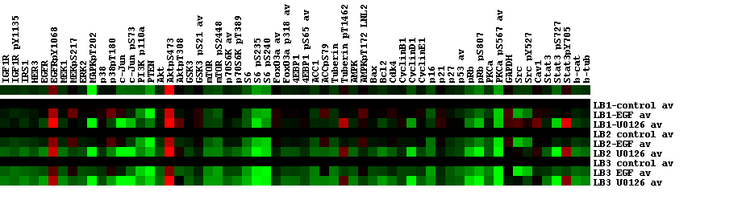
LBNL2
LB1-LB3 Averaged Samples Fold Difference over Control
Median Centered Separately by LB then Combined
Heatmap

Slide 8
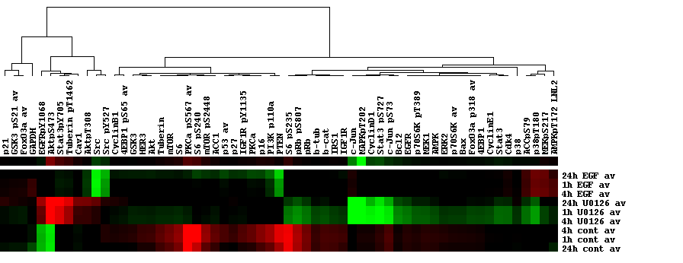

LBNL2
Time Course Averaged Samples
Median Centered Separately by Time then Combined
Pearson Correlation

Slide 9
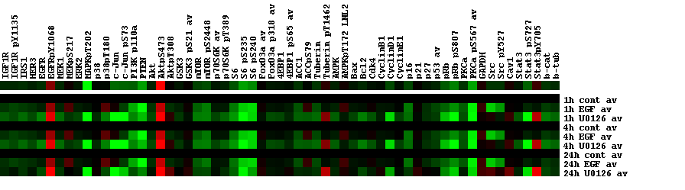
LBNL2
Time Course Averaged Samples Fold Difference over Control
Median Centered Separately by Time then Combined
Heatmap

